Slide 1
ONLINE CAR RENTAL & MECHANIC SERVICES
FINAL PROJECT
- Vaishnavi BHADRESH & mANISH Mukund kaujalgi

Slide 2
What is the application about?
It is about providing Car Rental services, Car maintenance support and repair related services where the spotlight is focused on Location Tracking based on the ZIPCODE.

Slide 3
Technologies Used
Java Servlet Pages
Model View Controller
Servlets
Java Beans
JavaScript
Java Database Connectivity
Database: MySQL
HTML
CSS

Slide 4
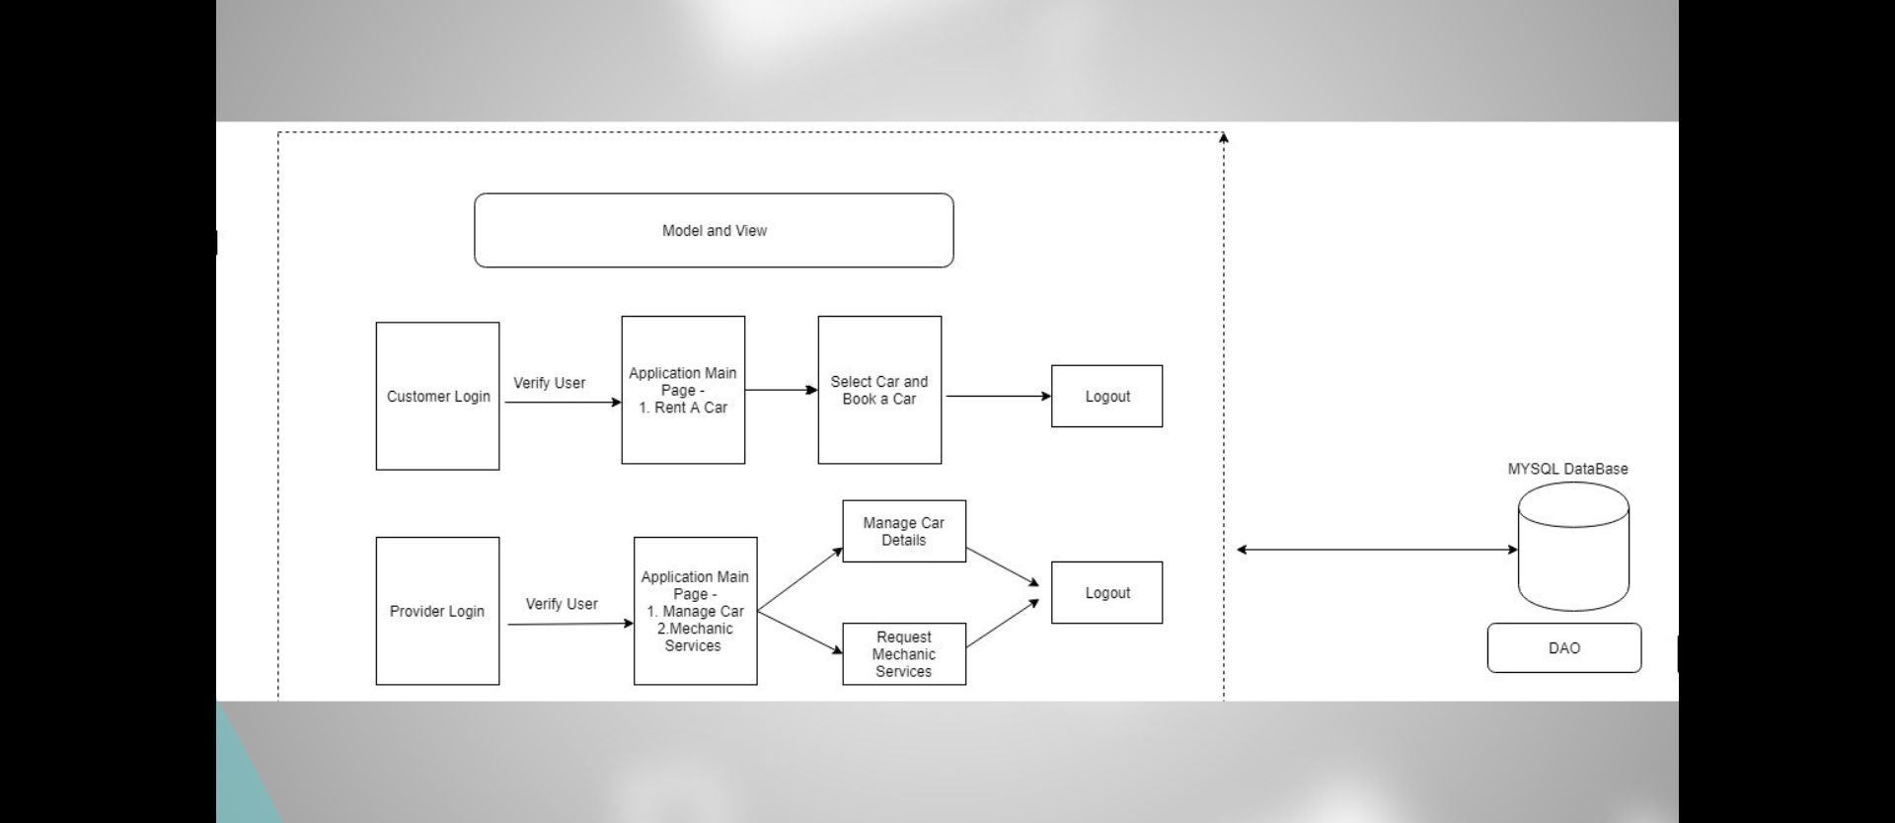
The Model – View – Controller as a outline in brief

Slide 5
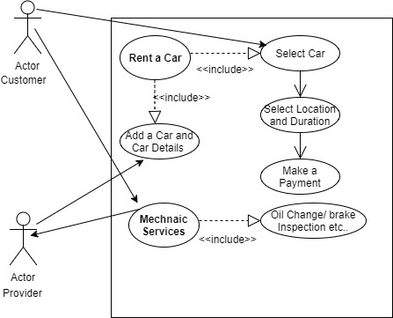
The Overall Compact Flow Diagram:

Slide 6
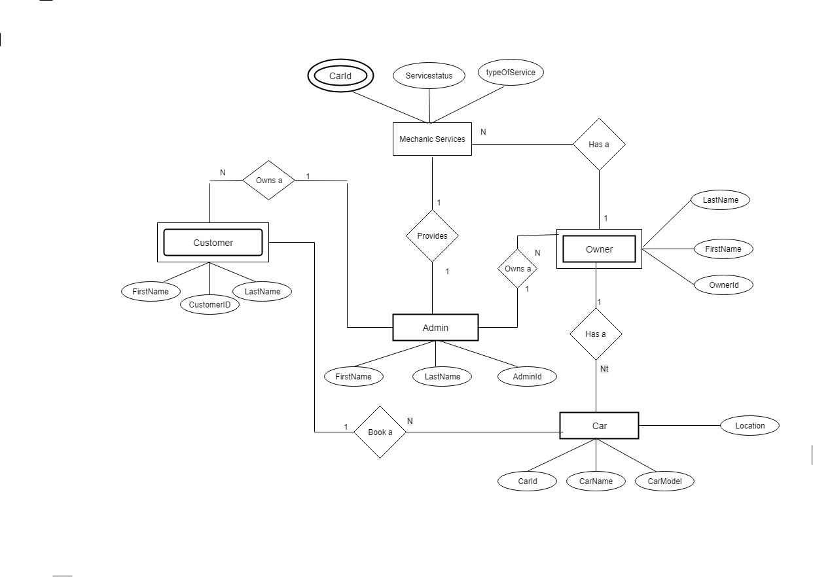
The Entity – Relationship as we see:

Slide 7
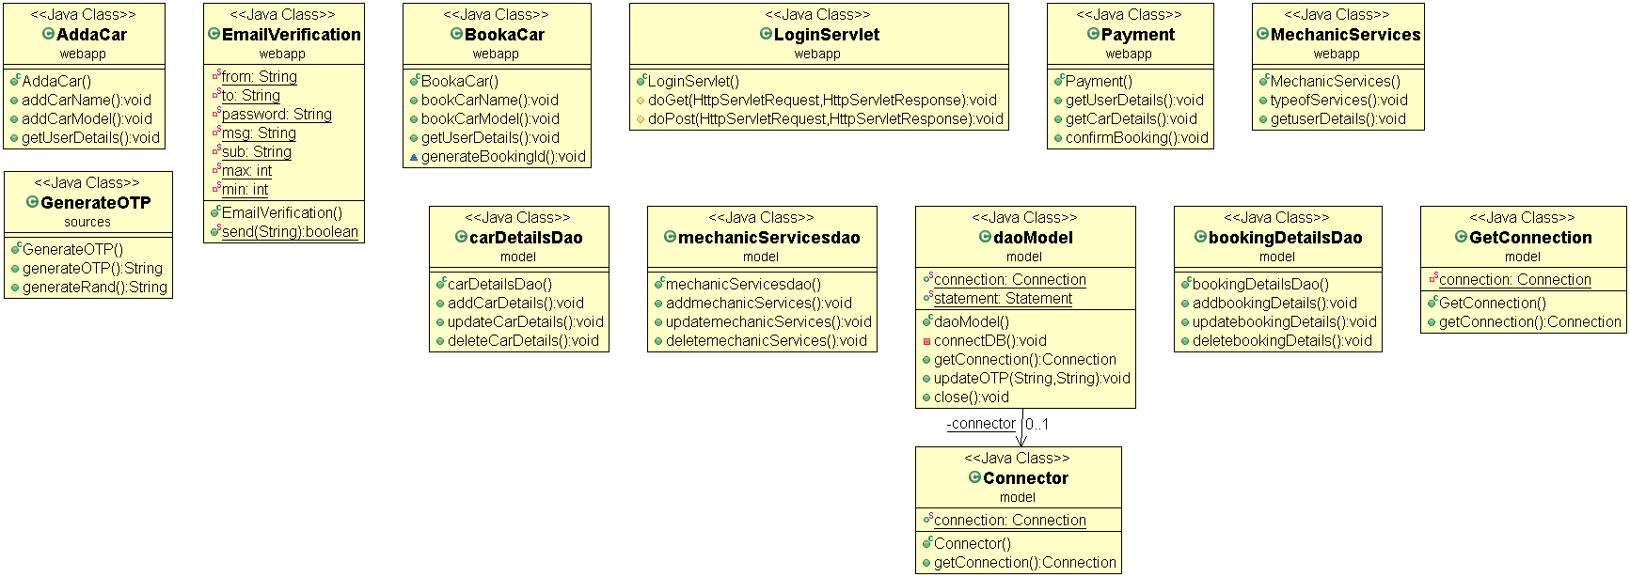
UML Diagram focused on major functional contributing classes:

Slide 8
A Big Thank YOU!
- Stay tuned for the project functional demo =)

